Slide 1
MACHINE LEARNING
ALGORITHMS
Nonlinear Machine Learning using Decision Tree and Naïve Bayes
ITMLA2-B44

Slide 2
Contents Covered
Understand the underlying concept behind nonlinear machine learning algorithms
Discuss and implement the Classification and Regression Trees (CART) models for data prediction
Discuss and implement Naive Bayes algorithms for categorical variables

Slide 3
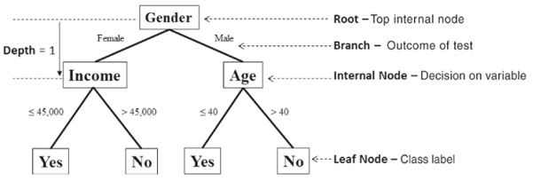
Nonlinear Machine Learning using Decision Trees
Decision Trees are non-parametric machine learning algorithms that can be used for both classification and regression, commonly called, CART, classification and regression trees.
Figure: Example of Decision Tree for Classification [EMC, Data Science and Big Data Analytics]
It is a graphical representation for getting all the possible solutions to a problem/decision based on given conditions.
It is called a decision tree because similar to a tree, it starts with the root node, which expands on further branches and constructs a tree-like structure.

Slide 4
CART are rule-based systems that construct an inference system based on which the output is determined.
In the example above, which aims to build a predictive model of mortgage defaulting, it can be seen that it is a problem of binary classification with three features (gender, age, income) and the decision tree has built a tree structure with test points and branches that have learned the inherent behaviour of customers based on the given dataset.
The top node is referred to as the root and is the starting decision node. (i.e., Gender is Male or Female?).
A branch is referred to as the outcome of a test.
Internal nodes are decision nodes based on which subsequent outcome results.
The depth of a node is the minimum number of steps it takes to reach it from the root node.
The leaf nodes are the end of the last branches on the tree which determine the output (class label or regression value).

Slide 5
Why use Decision Trees?
There are various algorithms in Machine learning, so choosing the best algorithm for the given dataset and problem is the main point to remember while creating a machine learning model. Below are the two reasons for using the Decision tree:
Decision Trees usually mimic human thinking ability while making a decision, so it is easy to understand.
The logic behind the decision tree can be easily understood because it shows a tree-like structure.
How does the Decision Tree algorithm Work?
In a decision tree, for predicting the class of the given dataset, the algorithm starts from the root node of the tree. This algorithm compares the values of the root attribute with the record (real dataset) attribute and based on the comparison, follows the branch and jumps to the next node.
For the next node, the algorithm again compares the attribute value with the other sub-nodes and moves further. It continues the process until it reaches the leaf node of the tree. The complete process can be better understood using the below algorithm:

Slide 6
Step-1: Begin the tree with the root node, says S, which contains the complete dataset.
Step 2: Find the best attribute in the dataset using the Attribute Selection Measure (ASM).
Step 3: Divide the S into subsets that contain possible values for the best attributes.
Step 4: Generate the decision tree node, which contains the best attribute.
Step-5: Recursively make new decision trees using the subsets of the dataset created in step -3. Continue this process until a stage is reached where you cannot further classify the nodes and called the final node as a leaf node.
Advantages of the Decision Tree
It is simple to understand as it follows the same process that a human follows while making any decision in real life.
It can be very useful for solving decision-related problems.
It helps to think about all the possible outcomes of a problem.
There is less requirement for data cleaning compared to other algorithms.

Slide 7
Step-1: Begin the tree with the root node, says S, which contains the complete dataset.
Step 2: Find the best attribute in the dataset using the Attribute Selection Measure (ASM).
Step 3: Divide the S into subsets that contain possible values for the best attributes.
Step 4: Generate the decision tree node, which contains the best attribute.
Step-5: Recursively make new decision trees using the subsets of the dataset created in step -3. Continue this process until a stage is reached where you cannot further classify the nodes and called the final node as a leaf node.
Advantages of the Decision Tree
It is simple to understand as it follows the same process that a human follows while making any decision in real life.
It can be very useful for solving decision-related problems.
It helps to think about all the possible outcomes of a problem.
There is less requirement for data cleaning compared to other algorithms.

Slide 8
Disadvantages of the Decision Tree
The decision tree contains lots of layers, which makes it complex.
It may have an overfitting issue, which can be resolved using the Random Forest algorithm.
For more class labels, the computational complexity of the decision tree may increase.

Slide 9

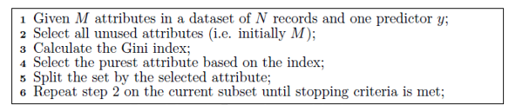
TRAINING A DECISION TREE
The first step in constructing a decision tree is to select the most informative attribute generally performed using entropy or information gain which have been previously discussed in the feature selection section.
In the typical case of CART trees, the Gini index is used to test the purity or importance of a feature. Several other decision trees variant exist besides the CART model (ID3, C4.5, etc).
where P(i|x) is the probability that the feature x belongs to the class i and j is the number of classes in the label. The lower the Gini index, the more informative the feature. Given the ranking score, decision-building proceeds by

Slide 10
A typical stopping criterion to stop the splitting criteria is the minimum count of training instances in the subset submitting to split. If the number of training instances goes below a certain threshold, recursive partitioning at the node in question stops.
PRUNING (to trim) A DECISION TREE
Because decision trees proceed by a recursive portioning of the dataset, they can tend to overfit the dataset, that is, learn it too well that are unable to generalise well. Thus, decision trees with fewer splits are often preferred and more likely to have better generalisation. Therefore, the decision tree becomes relevant to improve generalisation.
The easiest way to prune a decision tree is by walking through each leaf node in the tree and evaluating the performance effect of removing it using a hold-out test set.

Slide 11
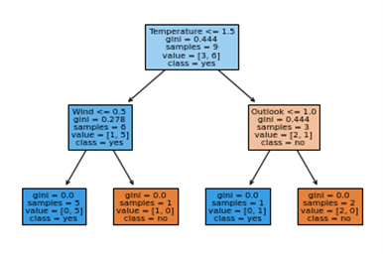

Slide 12
Nonlinear Classification using Naive Bayes

Slide 13


Naïve Bayes is a classification algorithm that is based on the probability Bayes Theorem with a few assumptions.
It aims to estimate the probability density of obtaining a given class (Y = y_i) given the input feature vector with certain values. Once, the probability density function (PDFs) for each class is learned from the dataset, classification can thus be performed easily. In order to compute such PDFs, Naïve Bayes makes two major assumptions.
ASSUMPTION 1: THE CONDITIONAL INDEPENDENCE OF EACH FEATURE
This assumption implies that the probability of occurrence of a given feature given the other features is independent of the remaining features. This assumption drastically simplifies the computation of the joint probability of the feature and the output variable:

Slide 14
ASSUMPTION 2: SINCE THE JOINT PROBABILITY OF FEATURES ACROSS ALL CLASSES IS CONSTANT, THE DENOMINATOR CAN BE IGNORED AND NOT COMPUTED.
And thus, Naïve Bayes does not compute true probability but a classification score to discriminate between classes:
Being, a fairly simple algorithm, Naïve Bayes can be computed even manually (i.e. for a very small dataset) or efficiently on computers.
A typical Naïve Bayes variant called “Gaussian Naïve Bayes” assumes the probability density P(xi|Y) to follow a normal (i.e. Gaussian) distribution and estimates these distributions per feature and for the output data to build the overall probability-based classification model.

Slide 15
THANK YOU

